Slide 1
Decentralized Perception from Online Learning and
Semantic Understanding
Enmao Diao
Eliahu (Ilya) Soloveychik
Vahid Tarokh
Duke University
Durham, NC
03/19/2019

Slide 2
Distributed Source Coding

Slide 3
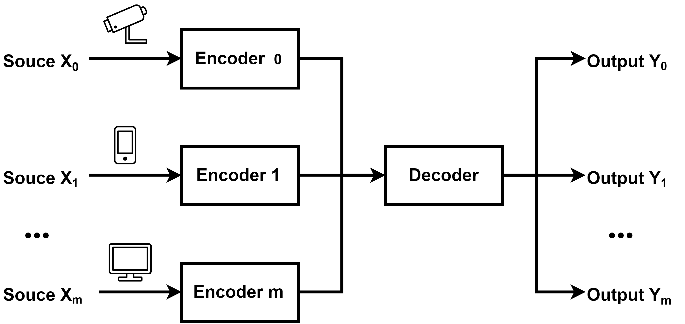
Distributed Source Coding (DSC)
A decoder would like to reconstruct observations at various sensors/cameras with minimal communications.

Slide 4
Slepian-Wolf Theorem
Sources are i.i.d. (not realistic)
They know their joint statistics (not fully realistic)
Lossless Compression (not of interest in most cases)
They do not know each other’s outcome
Separate encoding and decoding of X and Y
Separate encoding and joint decoding of X and Y

Slide 5
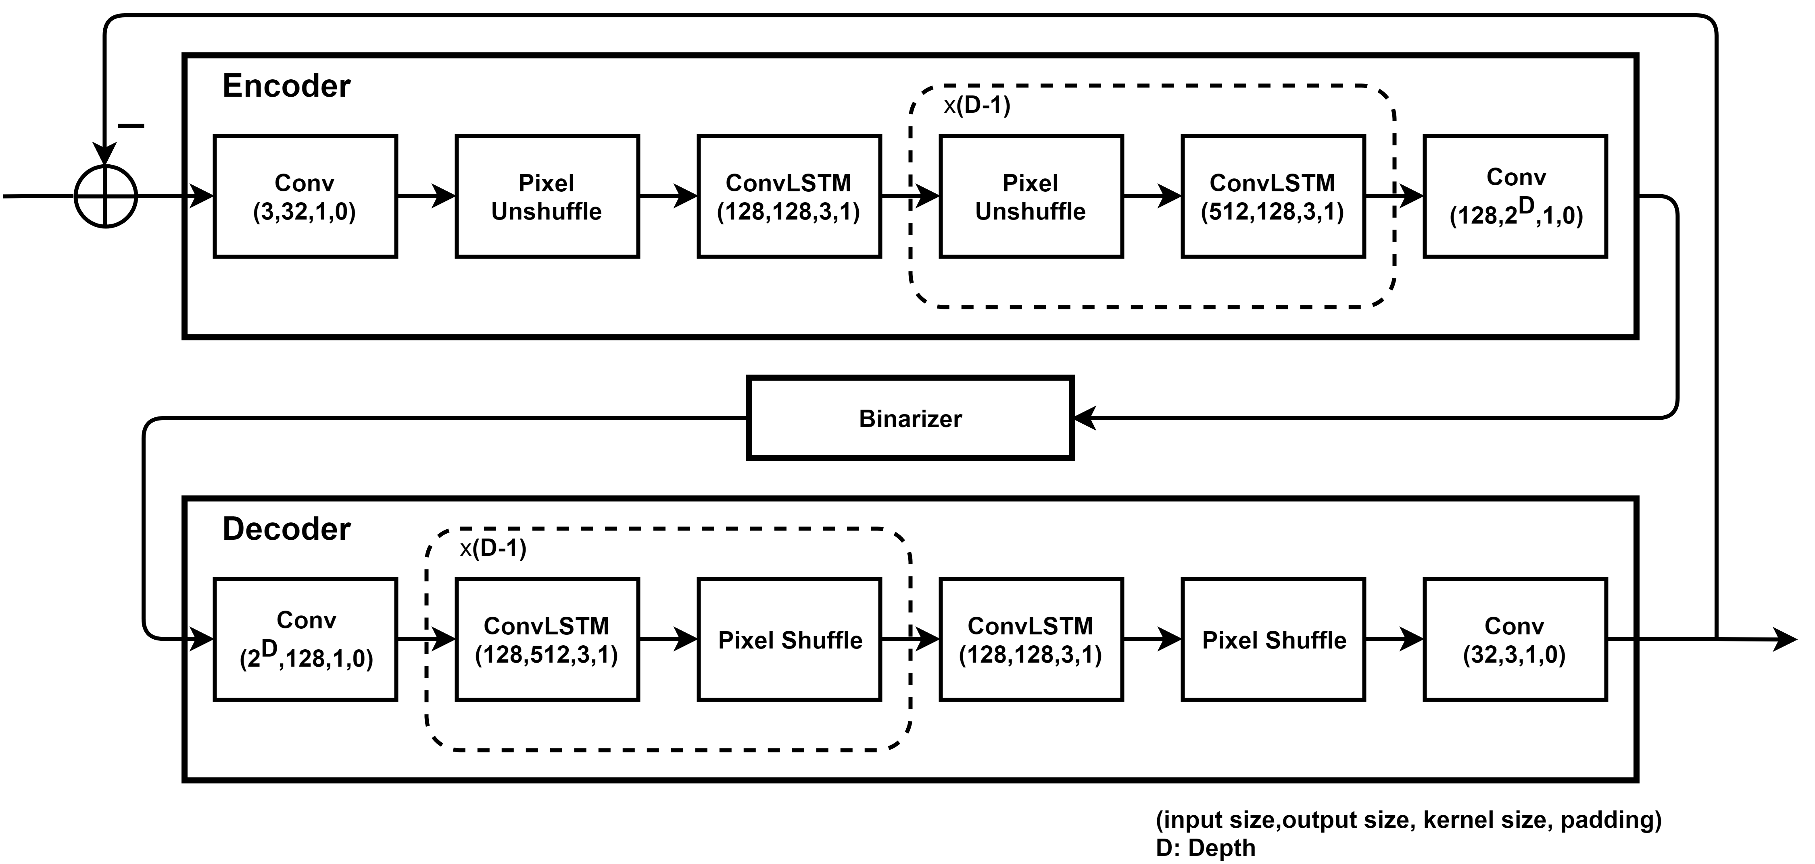
Deep Slepian-Wolf Architecture
Compression Module
Variable compression quality
The difference of input and reconstructed output are fed into the network at each iteration to generate codes. Compression quality can be controlled by the number of iterations

Slide 6
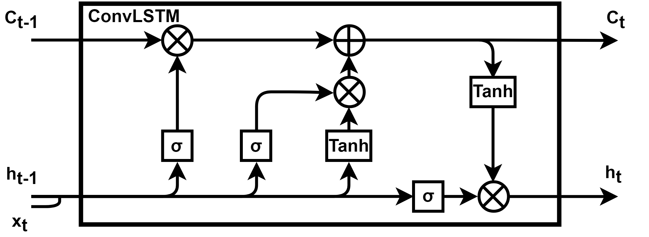
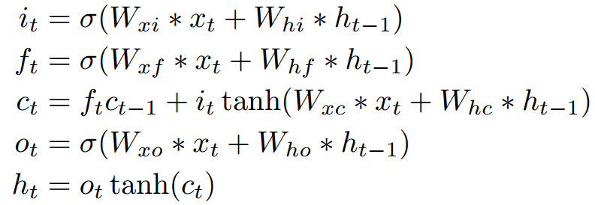
Convolutional LSTM
Compression Module
Convolutional LSTM
Replace Linear module in Long short term memory (LSTM) with Convolution module

Slide 7
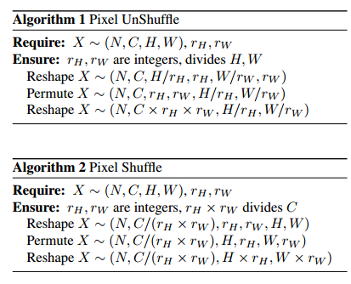
Deep Slepian-Wolf Architecture
Compression Module
Pixel UnShuffle is the inverse of pixel shuffle [7]
Compare to interpolation and convolution with different strides, pixel shuffle module is a non parametric (up)downsample module that is very easy to implement and computationally efficient
The shortcoming is we need many channels and downsample ratio has to be the power of 2
[7] Ledig, Christian, et al. "Photo-realistic single image super-resolution using a generative adversarial network." Proceedings of the IEEE conference on computer vision and pattern recognition. 2017.

Slide 8
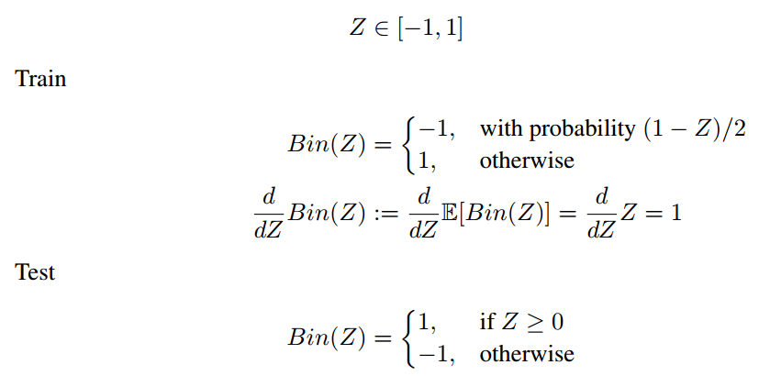
Deep Slepian-Wolf Architecture
Compression Module
Binarizer
Images are down-sampled from (3,32,32) to (8,4,4). The input of binarizer is in the range [-1,1] due to tanh(.) activation. Each element in the tensor is binarized with following equations. To approximate the noise from the quantization, we use a stochastic form of binarization during training.
[8] Theis, Lucas, et al. "Lossy image compression with compressive autoencoders." arXiv preprint arXiv:1703.00395 (2017).
[9] Toderici, George, et al. "Full resolution image compression with recurrent neural networks." Proceedings of the IEEE Conference on Computer Vision and Pattern Recognition. 2017.
[8,9]

Slide 9
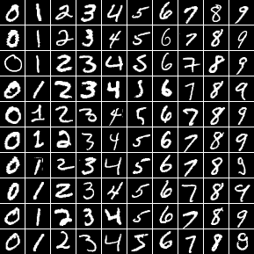
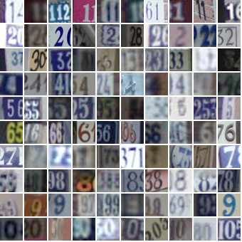
Experiment
Dataset
MNIST dataset
60000 handwritten 0-9 digits images for training, 10000 digits for testing, resized to 32x32
SVHN dataset
Street View House Numbers data containing 0-9 digits RGB cropped images. 73257 digits for training, 26032 digits for testing

Slide 10
Experiment
Distributed Source Coding
Experiment Specification
Training data are split into multiple subsets and each encoder only has access to one specific subset. We make sure no data are shared among those encoders.
We train with Stochastic Gradient Descent of batch size 100. We run 200 Epochs at learning rate 0.001 with Adam Optimizer.
The difference between the input image and reconstructed image is used at next iteration. Each iteration we accumulate 128 bits from one 32x32 image. We iterate 16 times and achieve 2 Bit Per Pixel (BPP) as total. The reconstructed image is the summation of reconstructed outputs of each iteration.
Further compression can be achieved with entropy coding but this was not attempted in the simulations.
We use L₁ Loss for reconstruction and measure PSNR vs. BPP.

Slide 11
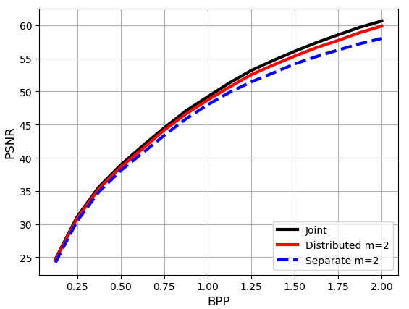
Experiment
Distributed Source Coding
We train on (2, 4, 8) number of encoders separately (separate) and one single decoder jointly (distributed). We compare the result to train the (2, 4, 8) number of encoders and decoders separately, and to one encoder, one decoder setting with the same amount compression (joint).
Each encoder is trained with subset of data inverse proportional to the number of encoders and tested with all test data separately. The result is averaged over all encoders

Slide 12
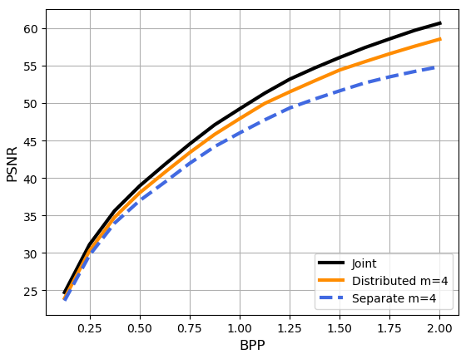
Experiment
Distributed Source Coding
We train on (2, 4, 8) number of encoders separately (separate) and one single decoder jointly (distributed). We compare the result to train the (2, 4, 8) number of encoders and decoders separately, and to one encoder, one decoder setting with the same amount compression (joint).
Each encoder is trained with subset of data inverse proportional to the number of encoders and tested with all test data separately. The result is averaged over all encoders

Slide 13
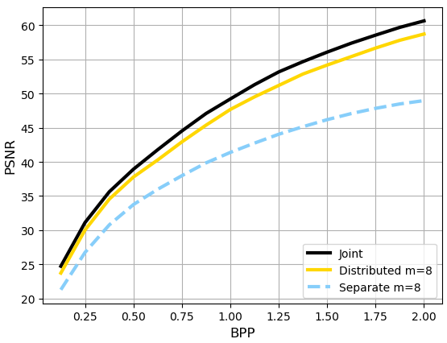
Experiment
Distributed Source Coding
We train on (2, 4, 8) number of encoders separately (separate) and one single decoder jointly (distributed). We compare the result to train the (2, 4, 8) number of encoders and decoders separately, and to one encoder, one decoder setting with the same amount compression (joint).
Each encoder is trained with subset of data inverse proportional to the number of encoders and tested with all test data separately. The result is averaged over all encoders

Slide 14
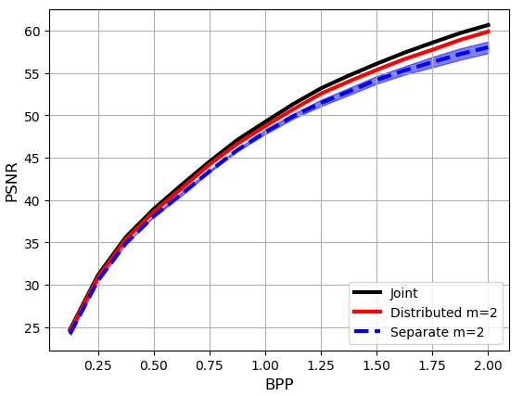
Experiment
Distributed Source Coding
Although our distributed encoders do not share parameters but the joint decoder compute gradients over all compressed data. Therefore, each encoder can benefit from other input images without directly communicate with other encoders
The performance band is plot from the best and worst possible performance of all encoders. Our result is very robust against hijacking and blockage

Slide 15
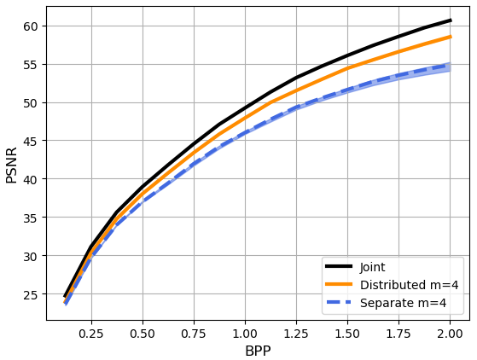
Experiment
Distributed Source Coding
Although our distributed encoders do not share parameters but the joint decoder compute gradients over all compressed data. Therefore, each encoder can benefit from other input images without directly communicate with other encoders
The performance band is plot from the best and worst possible performance of all encoders. Our result is very robust against hijacking and blockage

Slide 16
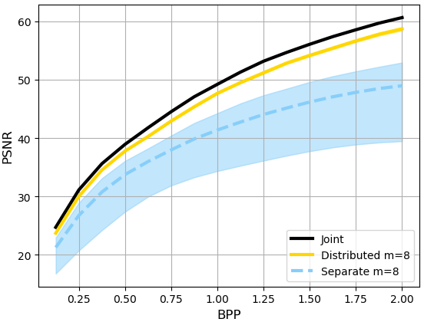
Experiment
Distributed Source Coding
Although our distributed encoders do not share parameters but the joint decoder compute gradients over all compressed data. Therefore, each encoder can benefit from other input images without directly communicate with other encoders
The performance band is plot from the best and worst possible performance of all encoders. Our result is very robust against hijacking and blockage

Slide 17
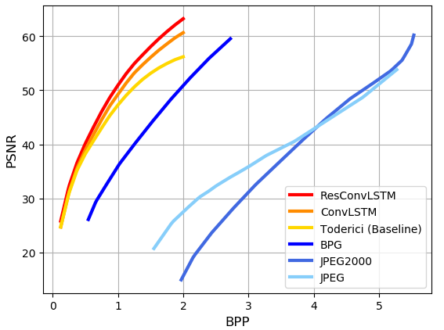
Experiment
Distributed Source Coding
We also compare the performance of joint training codec with classical codecs like JPEG and BPG. Our results outperform classical codecs and previous works on Image Compression with Deep Learning proposed by Google
[9] Toderici, George, et al. "Full resolution image compression with recurrent neural networks." Proceedings of the IEEE Conference on Computer Vision and Pattern Recognition. 2017.

Slide 18
Classification Based on Compressed Data

Slide 19
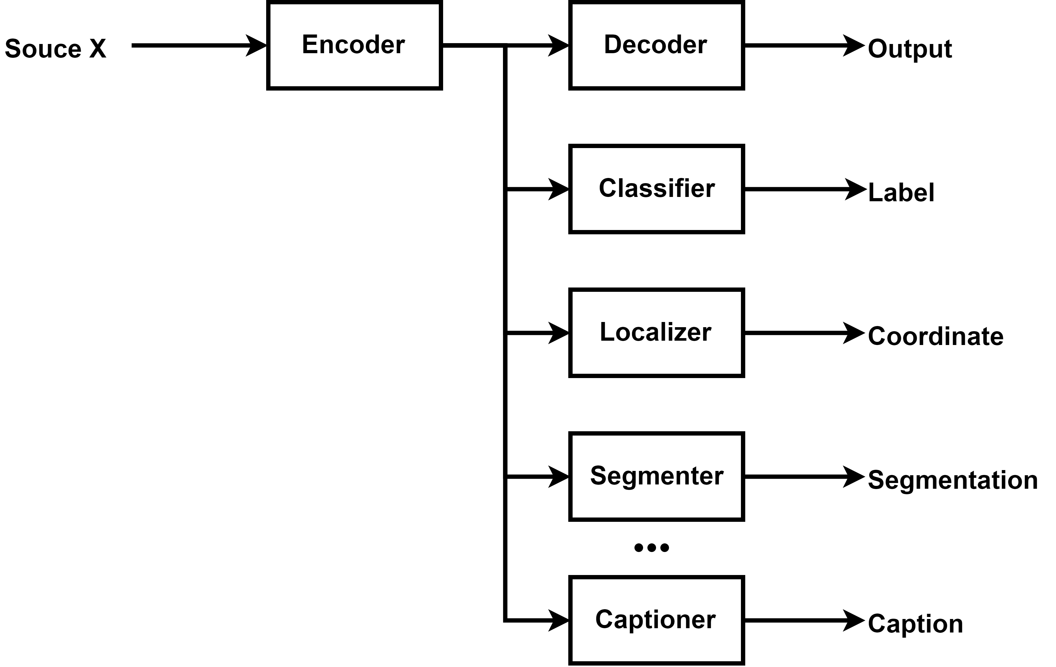
Framework
Image Classification based on compressed domain
In a band-limited scenario, highly compressed codes are transmitted and used for different tasks

Slide 20
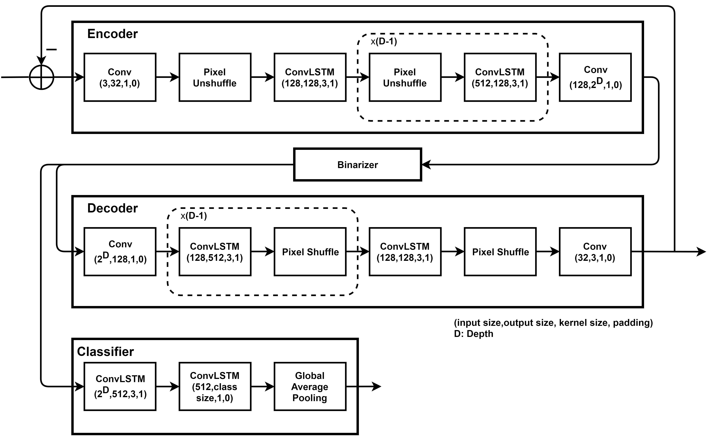
Architecture
Classification Module
Variable classification performance
More codes can achieve better classification performance. User can control this trade-off after receiving the codes

Slide 21
Experiment
Dataset
MNIST dataset
60000 handwritten 0-9 digits images for training, 10000 digits for testing, resized to 32x32
SVHN dataset
Street View House Numbers data containing 0-9 digits RGB cropped images. 73257 digits for training, 26032 digits for testing

Slide 22
Experiment
Classification Based on Compressed Data
Experiment Specification
We train with Stochastic Gradient Descent of batch size 100. We run 200 Epochs at learning rate 0.001 with Adam Optimizer.
The difference between the input image and reconstructed image is used at next iteration. Each iteration we accumulate 128 bits from one 32x32 image. We iterate 16 times and gain 2 Bit Per Pixel as total.
The outputs of classifier over each iteration are accumulated and the predicted probability at each iteration is equal to softmax(.) of these accumulated results.
We jointly optimize reconstruction and classification loss. We use L₁ Loss for reconstruction and Cross Entropy Loss for classification. We do not fine tune the balancing weight between reconstruction and classification loss. We can enhance classification performance by attenuating reconstruction performance. We measure PSNR vs. BPP, Accuracy vs. BPP and ROC vs. BPP.

Slide 23
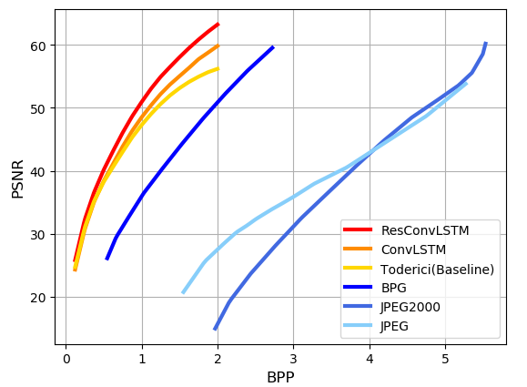
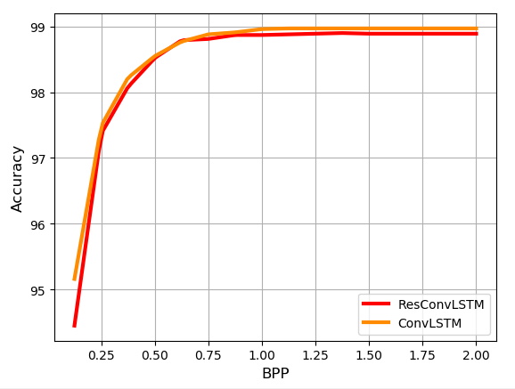
Experiment
Classification Based on Compressed Data (MNIST)
We also compare the performance of joint training codec with classical codecs like JPEG and BPG. Our results outperform classical codecs and previous works on Image Compression with Deep Learning proposed by Google. Our model can perform compression and classification at the same time.
[9] Toderici, George, et al. "Full resolution image compression with recurrent neural networks." Proceedings of the IEEE Conference on Computer Vision and Pattern Recognition. 2017.

Slide 24
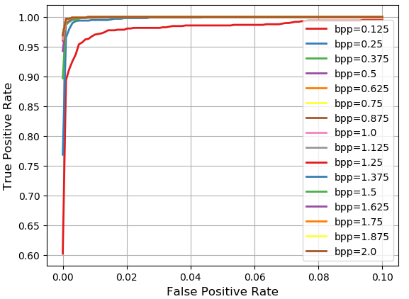
Experiment
Classification Based on Compressed Data (MNIST)
We show ROC curve of our classifier with Convolutional LSTM module across different BPP

Slide 25
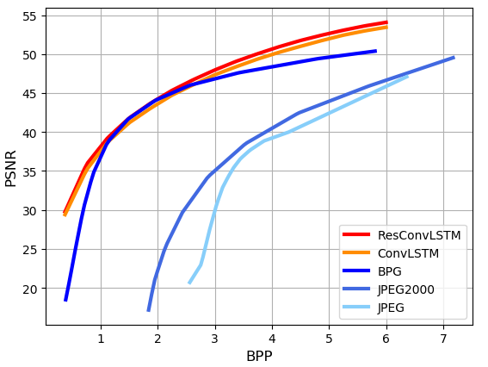
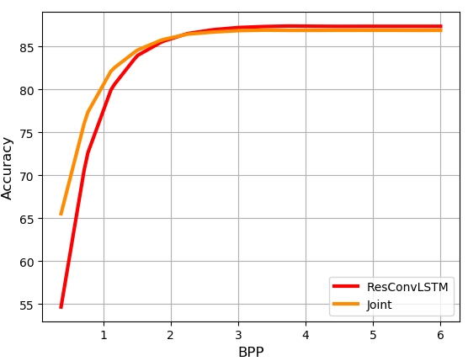
Experiment
Classification Based on Compressed Data (SVHN)
We also compare the performance of joint training codec with classical codecs like JPEG and BPG. Our results outperform classical codecs and previous works on Image Compression with Deep Learning proposed by Google. Our model can perform compression and classification at the same time.

Slide 26
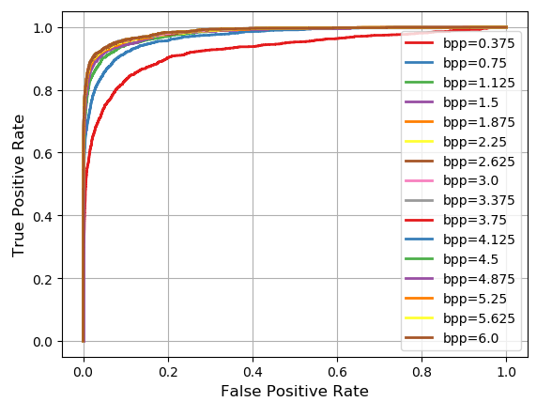
Experiment
Classification Based on Compressed Data (SVHN)
We show ROC curve of our classifier with Convolutional LSTM module across different BPP

Slide 27
Summary
Proposed a framework for performing image classification and other tasks on compressed domain
Proposed a framework for realizing Slepian-Wolf Theorem with Deep Learning model
We show distributed encoders and joint decoder has dominant advantage over independent trained codecs
Demonstrated the robustness of our framework in the above.
As a byproduct, our result produced a data-driven image codec that outperforms classical codecs.

Slide 28
Thank You

